Slide 1
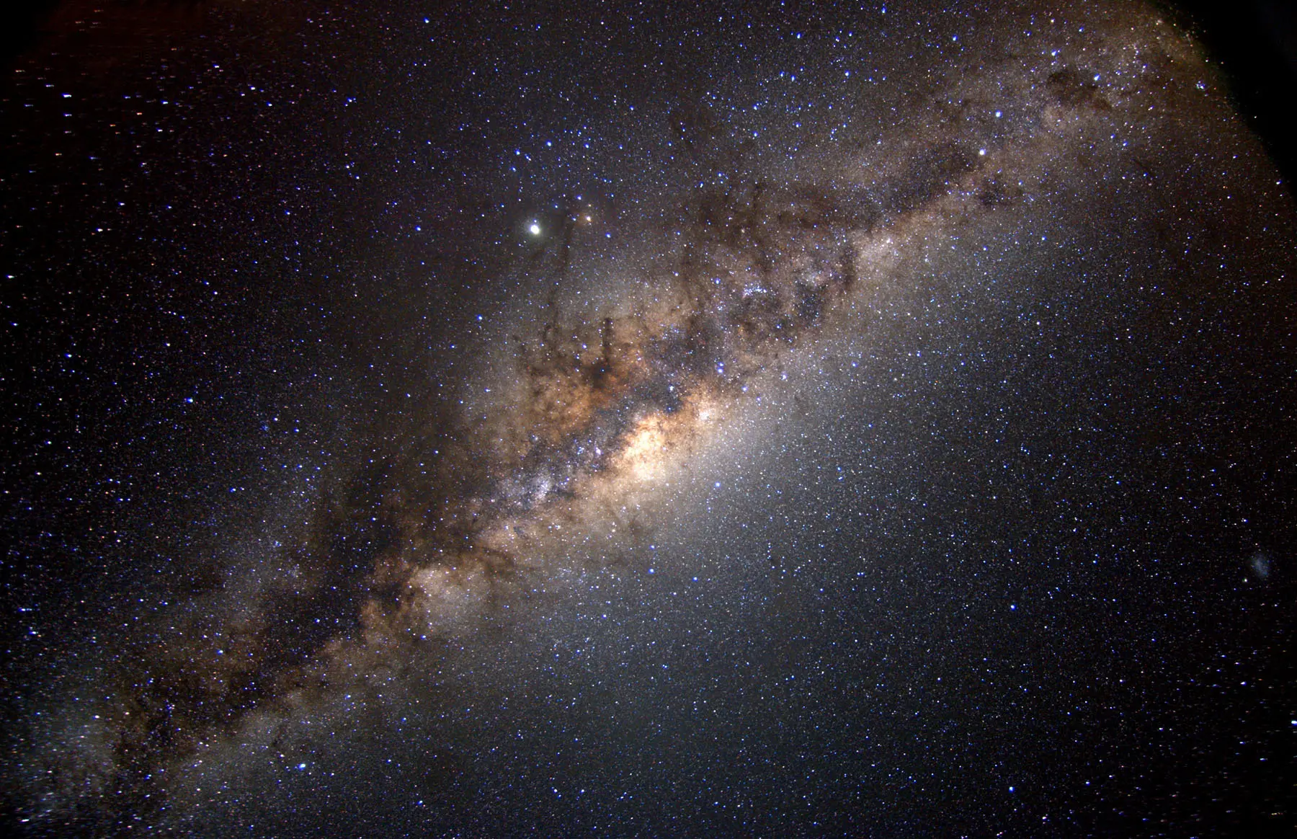

Introduction to Python for Astronomy
Unlocking the Universe with Code
Dr. John Hoang July 12, 2025

Slide 2
Agenda
Mini presentation
Introduction to Python
Why Python is Ideal for Astronomy
Essential Python Libraries for Astronomers
Code Demos
Setting up and simple examples
Coding time with real-life examples

Slide 3
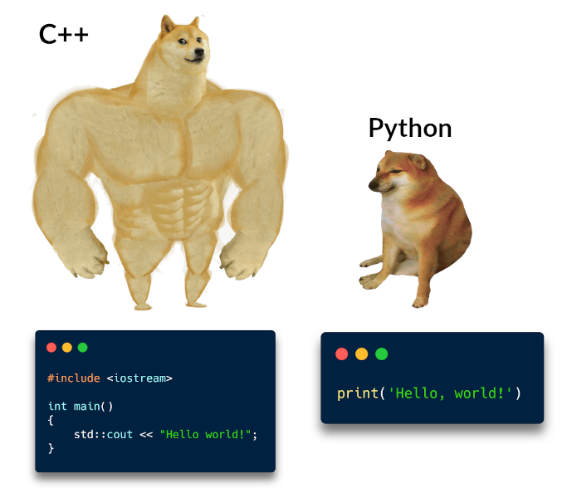
What is Python?
High‑level, interpreted language (1991, Amsterdam)
Easy to learn, easy to use
Huge community supports and vast libraries
Versatile: web, data science, scientific computing, AI

Slide 4
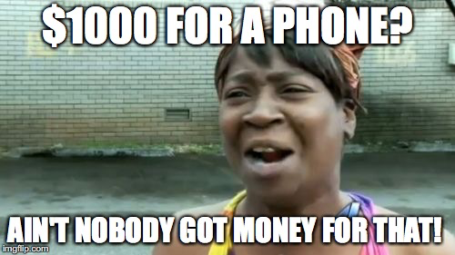
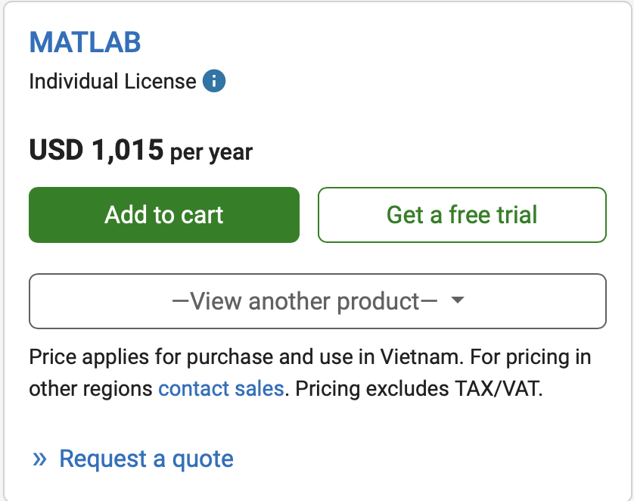
Why Python in Astronomy?
It’s free!
Strong adoption and community support in astrophysics
Surveys show >90 % of astronomers use Python for data analysis
Support for the majority of astro data formats
Handles massive datasets from modern telescopes & simulations
Automation: schedule observations, analyse spectra, model orbits
software

Slide 5
Essential Python Libraries for Astronomy
Library | Purpose | Astronomy Example
NumPy | Numerical arrays & math | Handling pixel data
SciPy | Optimisation, integration, stats | Fitting spectral lines
Matplotlib | Plotting & visualisation | Graphing light curves
Pandas | Tables & time‑series | Galaxy catalog analysis
Astropy | Astronomy‑specific core | Coordinate transforms
TensorFlow/Pytorch | AI/Machine Learning | Object Classification

Slide 6
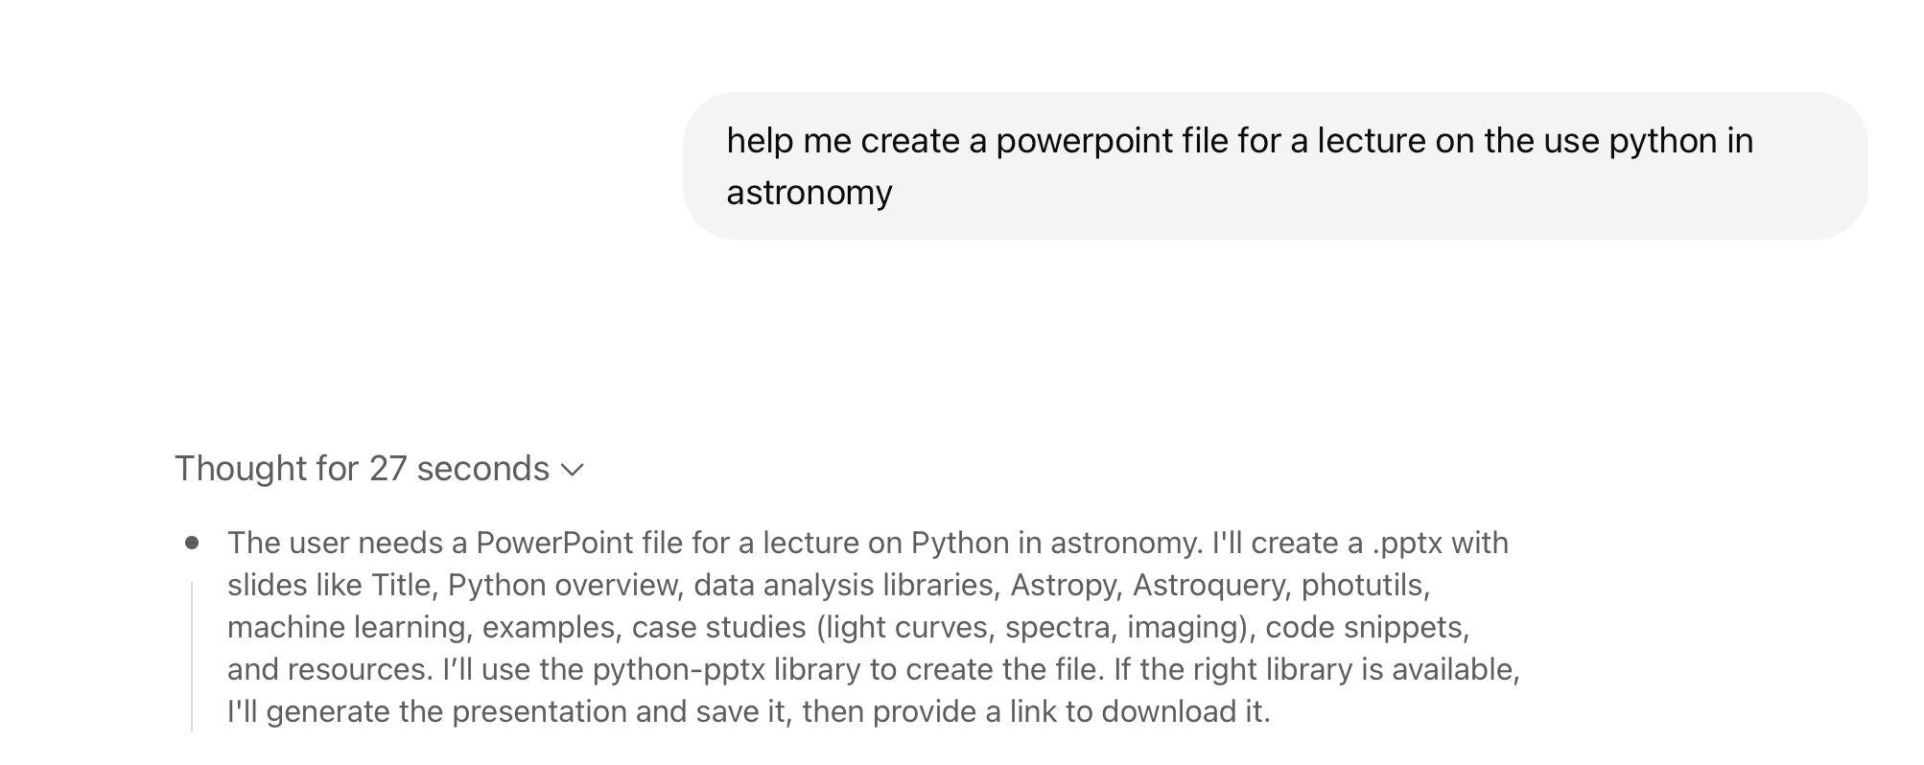
On the use of ChatGTP/Grok/Gemini

Slide 7
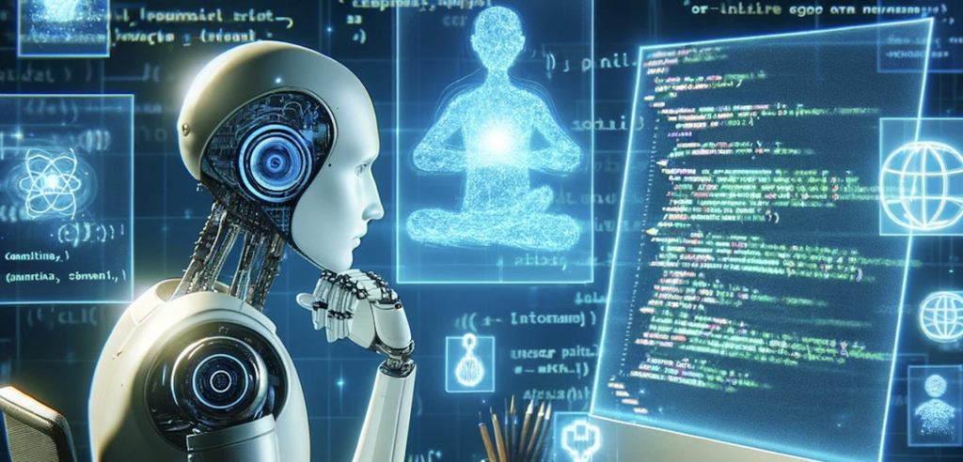
On the use of ChatGTP/Grok/Gemini
Python saves your (developing) time from C++!
Risk: you need “better” hardware for Python
AI-assisted coding saves you even more time!
Risk: AI can and will make mistakes (hallucination)
Do NOT trust them 100%!
Use when you can, avoid when you must

Slide 8
Conclusion
Python is a must-have for any astronomer!
It’s easy. Start coding today!
Questions?

Slide 9

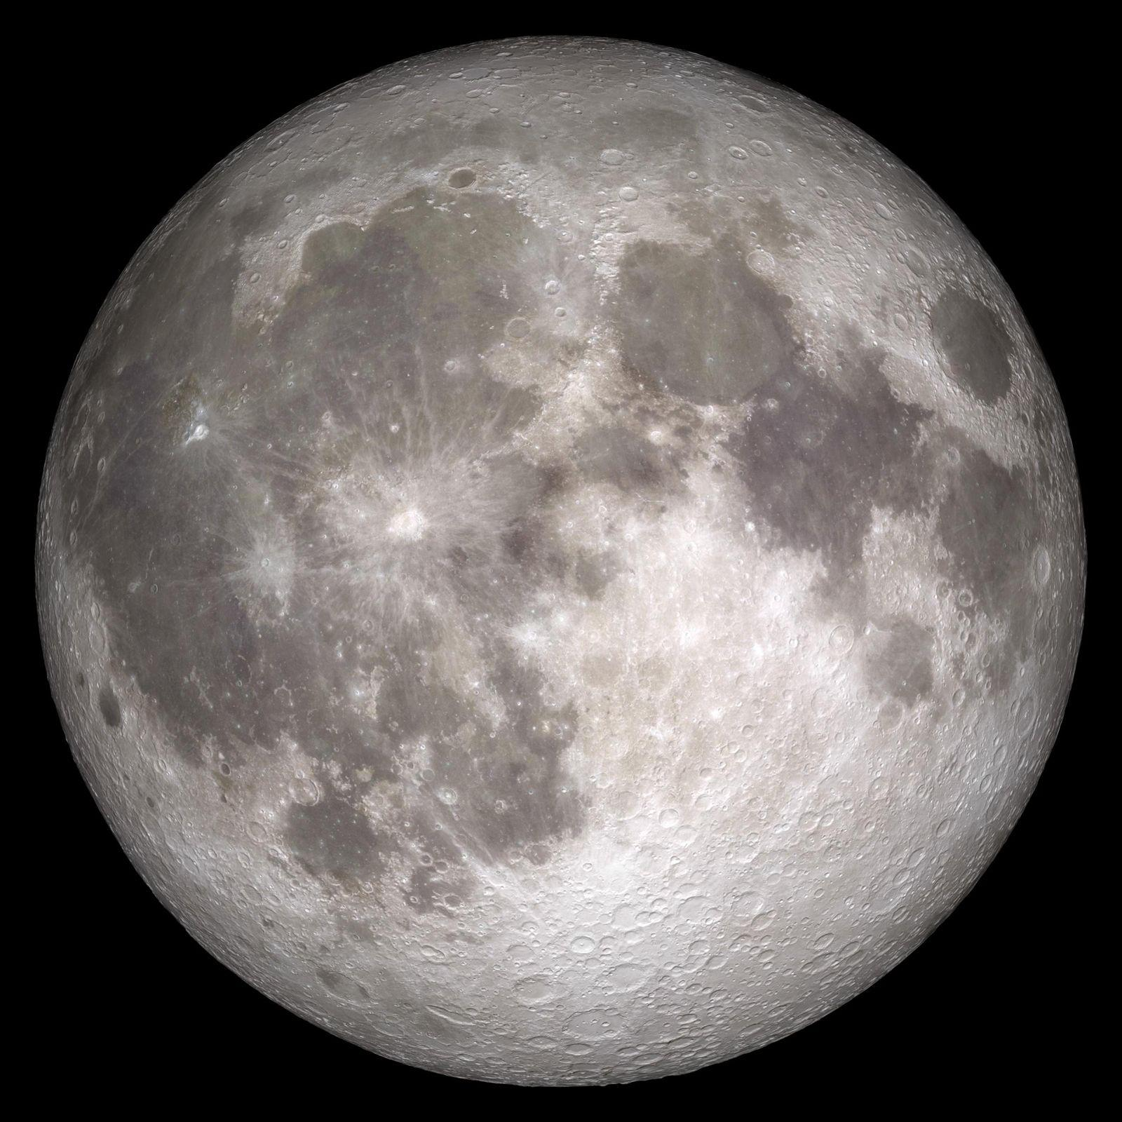
Coding project: moon rise
Above is a video of a “moon rise” captured by a special type of camera
Saved as MP4 movie file
Your tasks:
Open the file and use python to plot an image of the moon from the file
Align the obtained image with the full_moon_image to identify the landmark

Slide 10
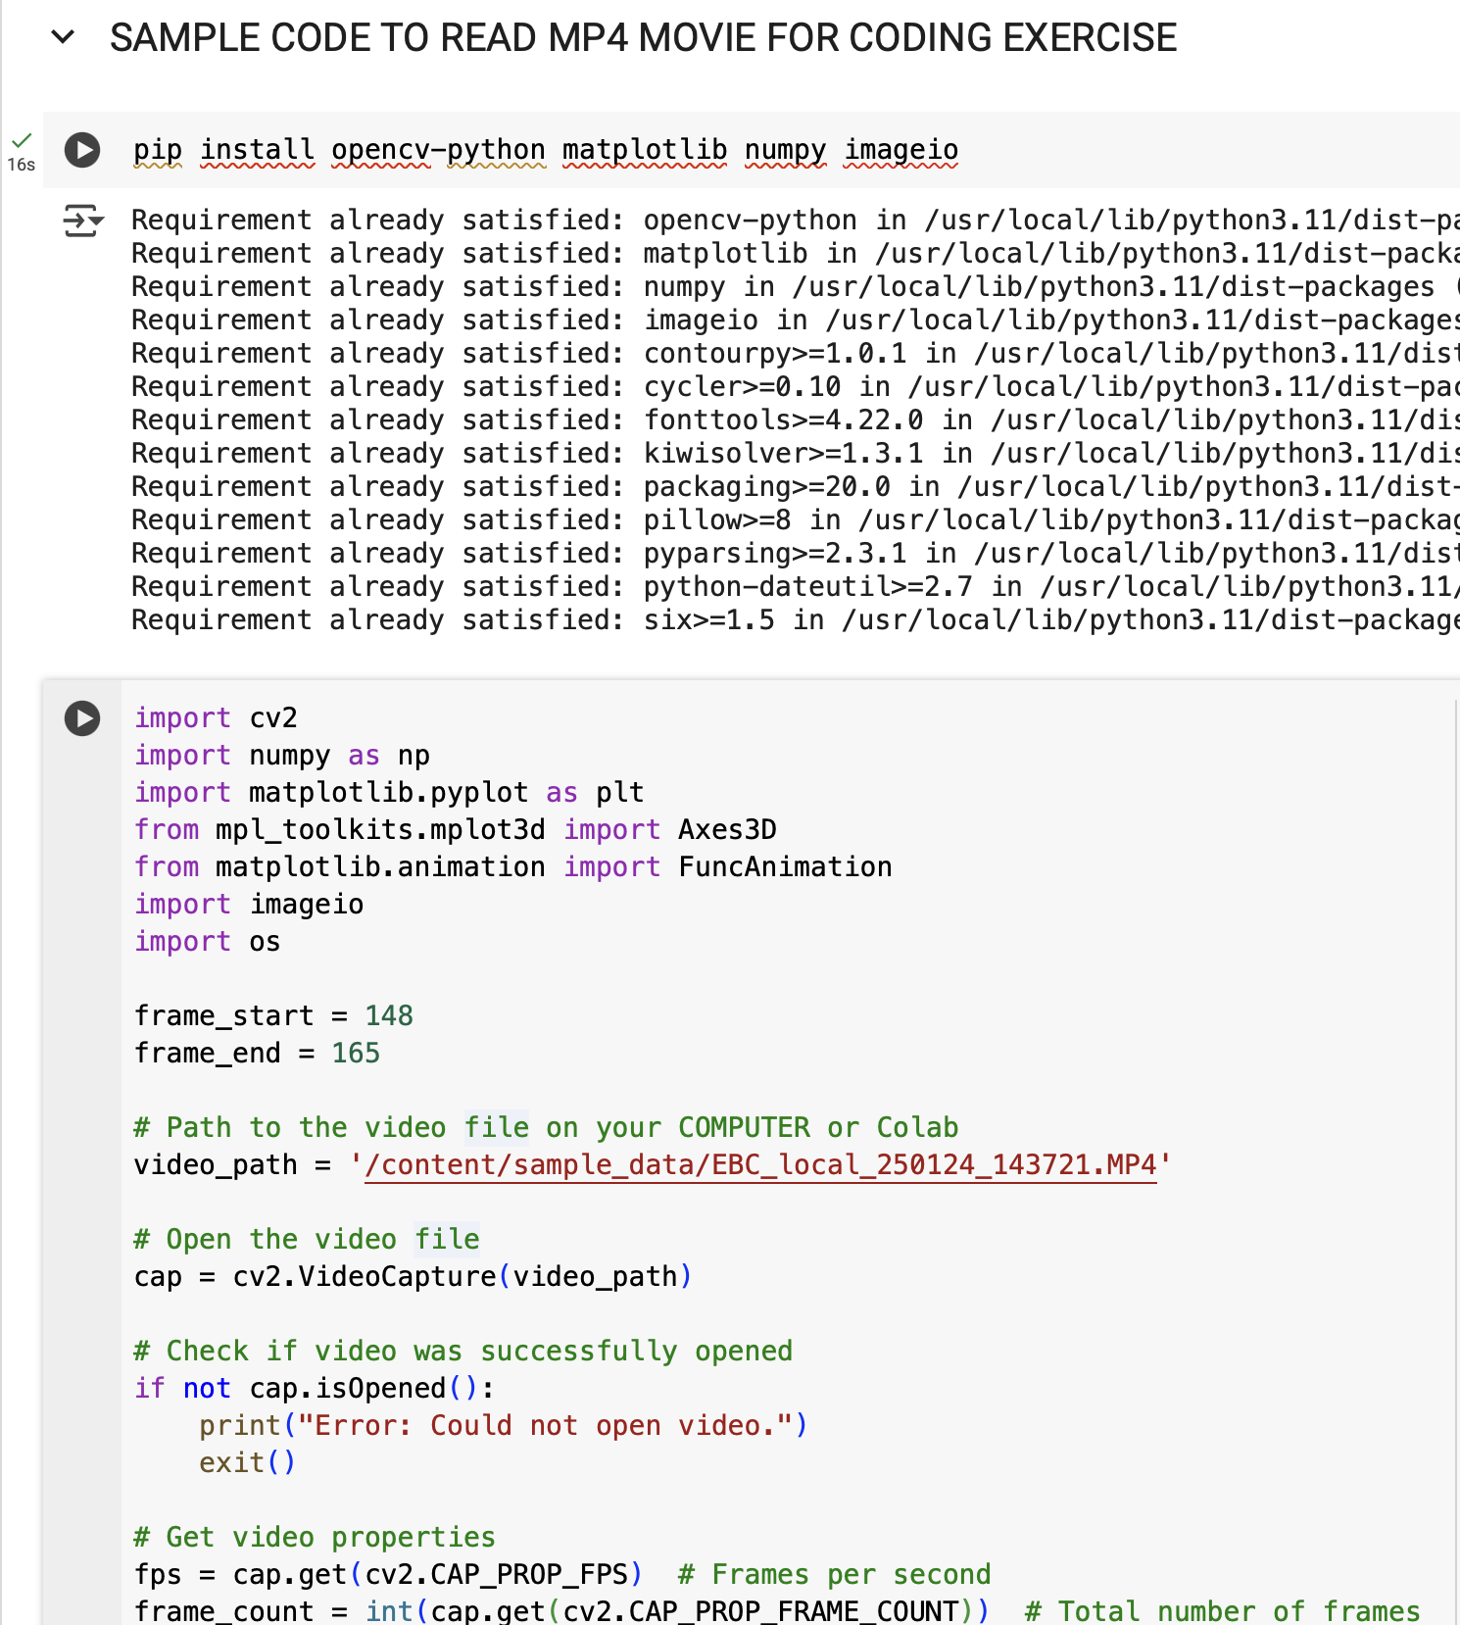
Coding project: moon rise
Work in pair/ team of 3
Instructions
Go to school’s github: https://github.com/johnkimdinh/sagi_summer_school_2025
Download the MP4 and JPEG file
Use the sample code to install necessary library and help you get started with reading the file.
Remember: AI when you can, your brain when you must!
Happy coding!

